Slide 1
CS5112: Algorithms and Data Structures for Applications
Streaming algorithms
Ramin Zabih
Some content from: Wikipedia;
J. Leskovec, A. Rajaraman, J. Ullman: Mining of Massive Datasets, http://www.mmds.org

Slide 2
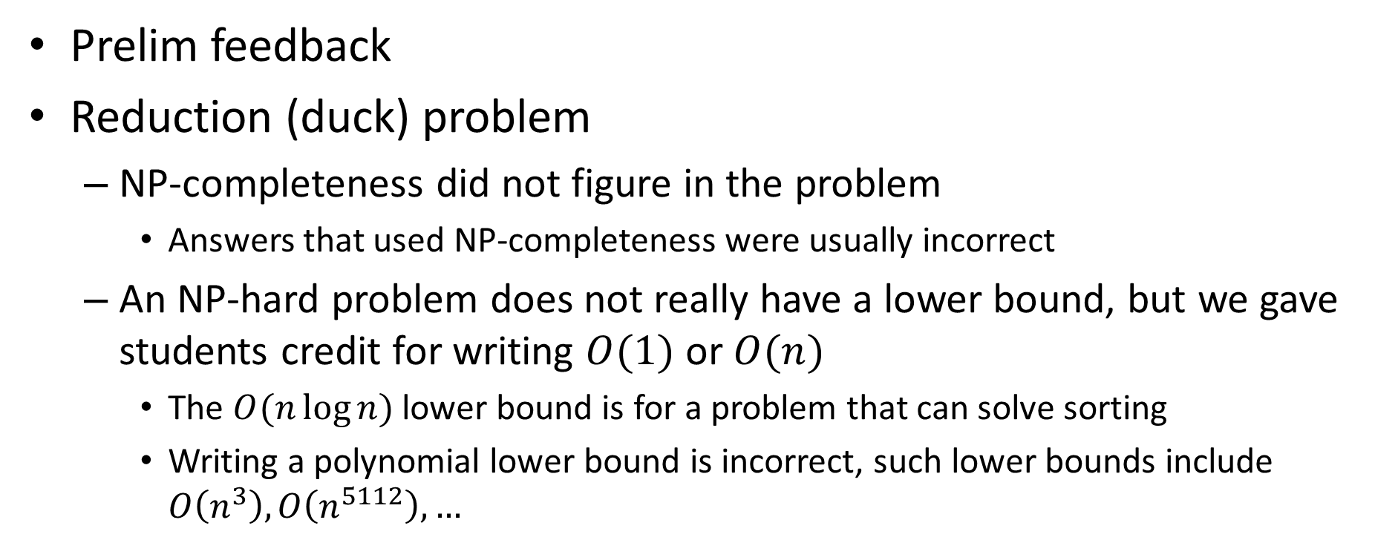
Administrivia
Prelim feedback
Reduction (duck) problem
NP-completeness did not figure in the problem
Answers that used NP-completeness were usually incorrect
An NP-hard problem does not really have a lower bound, but we gave students credit for writing $O(1)$ or $O(n)$
The $O(n\log{n})$ lower bound is for a problem that can solve sorting
Writing a polynomial lower bound is incorrect, such lower bounds include $O\left(n^{3}\right),O\left(n^{5112}\right), …$
Notes:
Don’t assume accidental properties are important. Ex: our graphs have <100 nodes.

Slide 3
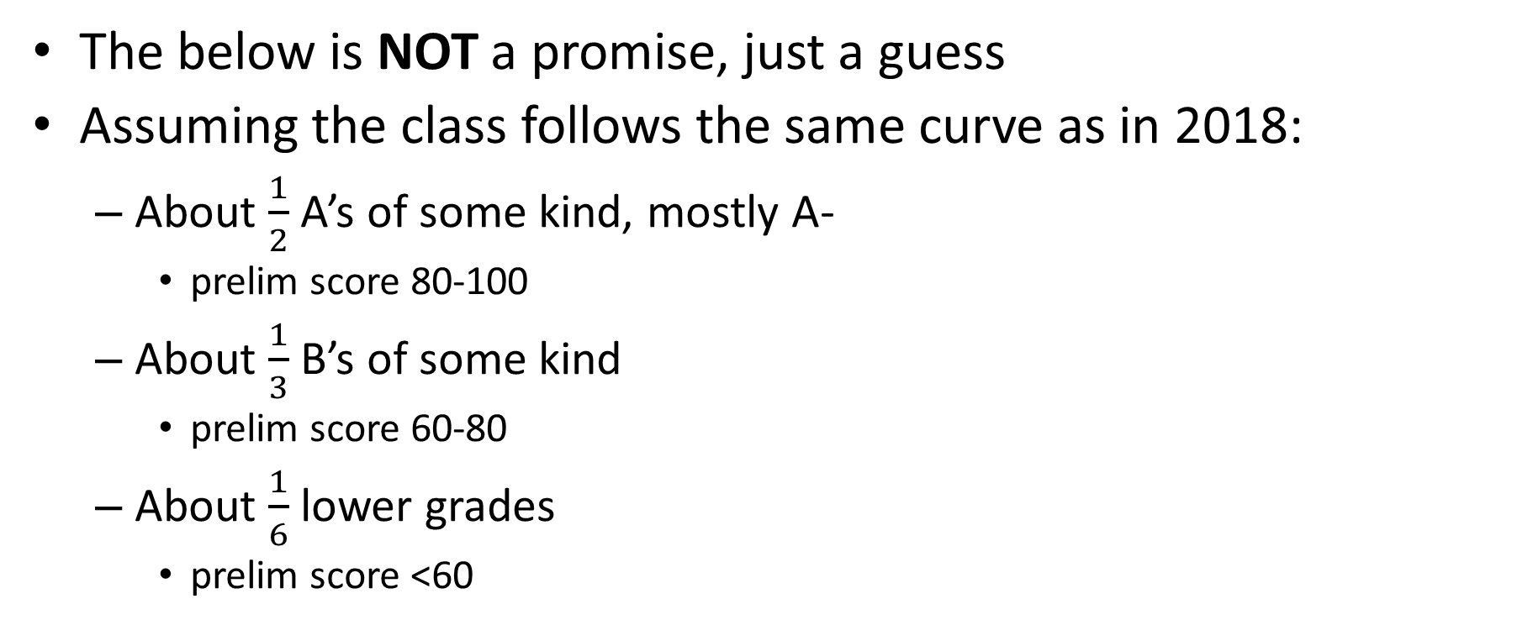
Non-binding grade estimates from prelim
The below is NOT a promise, just a guess
Assuming the class follows the same curve as in 2018:
About $\frac{1}{2}$ A’s of some kind, mostly A-
prelim score 80-100
About $\frac{1}{3}$ B’s of some kind
prelim score 60-80
About $\frac{1}{6}$ lower grades
prelim score <60

Slide 4
Lecture Outline
Online data processing
Histogram properties
Majority estimation via Boyer Moore
Misra-Gries generalization
Hashing-based streaming algorithms
Flajolet-Martin
Bloom filters

Slide 5
Online algorithms and approximations
Many AI/ML applications hinge on understanding the distribution of your input data
Classification is just one example (is this a cat video?)
Classically we assume that all the input data is available
You can run an offline algorithm over it
Then do NN classification, etc.
This assumption is often wrong: data comes streaming in
And you cannot afford to store the entire data set

Slide 6
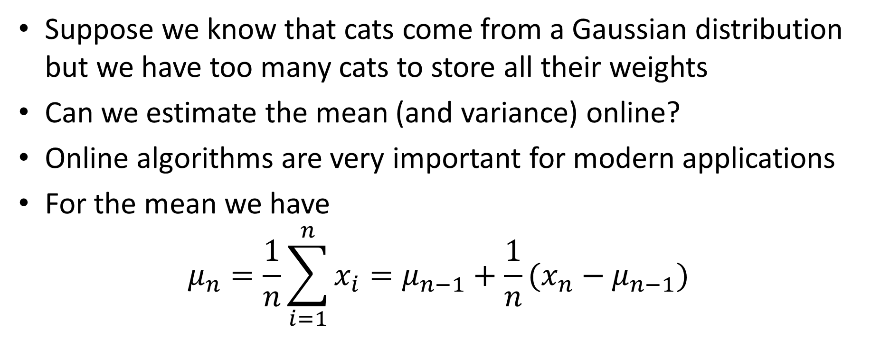
Welford’s online mean algorithm
Suppose we know that cats come from a Gaussian distribution but we have too many cats to store all their weights
Can we estimate the mean (and variance) online?
Online algorithms are very important for modern applications
For the mean we have
$$μ_{n}=\frac{1}{n}\sum_{i=1}^{n}{x_{i}}=μ_{n−1}+\frac{1}{n}(x_{n}−μ_{n−1})$$

Slide 7
Some natural histogram queries
Top-k most frequent elements
1 2 3 4 5 6 7 8 9 10 11 12 13 14 15 16 17 18 19 20
Find all elements
with frequency > 0.1%
What is the frequency
of element 3?
What is the total frequency
of elements between 8 and 14?
How many elements have non-zero frequency?
Notes:
Slide taken from Motwani and

Slide 8
Why approximation?
Suppose you want an (exact) histogram of your data
This requires space linear in the number of data points
This is intractable for many internet applications!
Examples:
IP addresses for DDOS detection
Most popular page/item to buy
Is this web site worth caching or is it a ‘one hit wonder’?

Slide 9
Streaming algorithms
We will use a small amount of space but solve the problem approximately
But, not precisely the same problem
Instead of computing the histogram we will look at several key properties of a histogram we can efficiently approximate
Typically with constant or logarithmic space and time

Slide 10
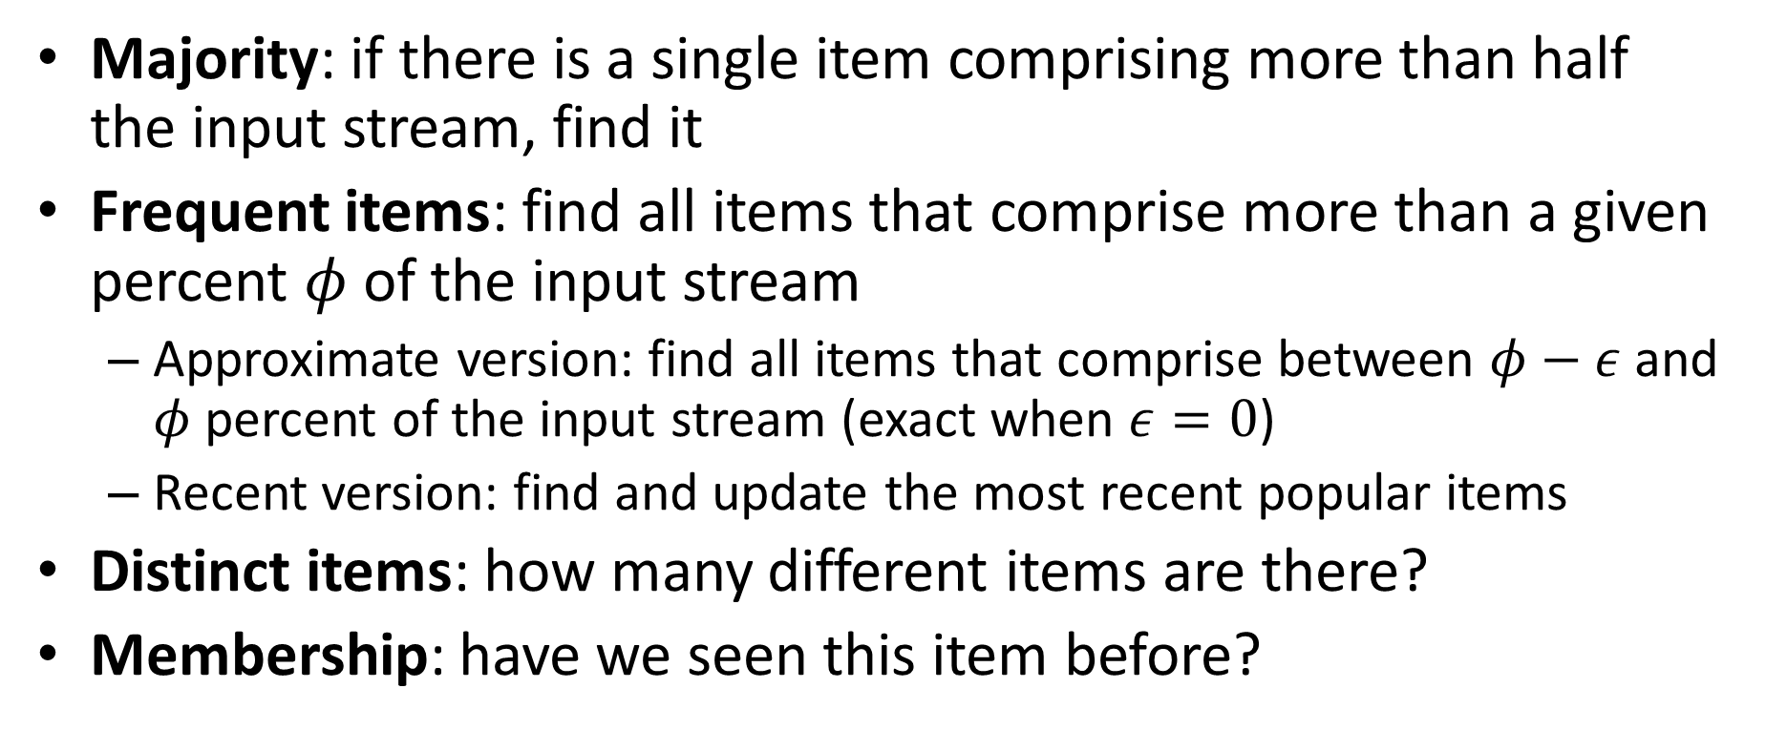
Relevant quantities to compute
Majority: if there is a single item comprising more than half the input stream, find it
Frequent items: find all items that comprise more than a given percent $φ$ of the input stream
Approximate version: find all items that comprise between $φ−ε$ and $φ$ percent of the input stream (exact when $ε=0$)
Recent version: find and update the most recent popular items
Distinct items: how many different items are there?
Membership: have we seen this item before?

Slide 11
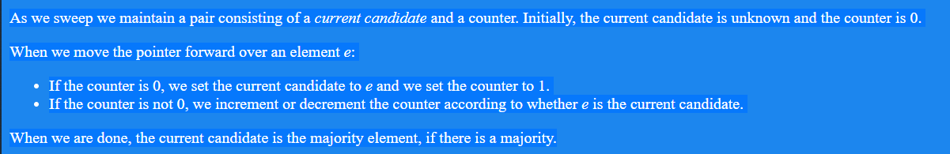
1. Boyer-Moore majority algorithm
Majority: one element is more than half the population
Easy offline. How do we do this online??
Algorithm according to Moore:
Source

Slide 12
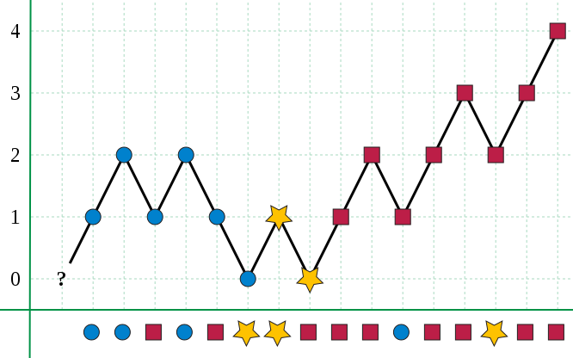
Boyer-Moore algorithm example
Source
Notes:
Subtlety: counter value doesn’t mean much at the end, for general input

Slide 13
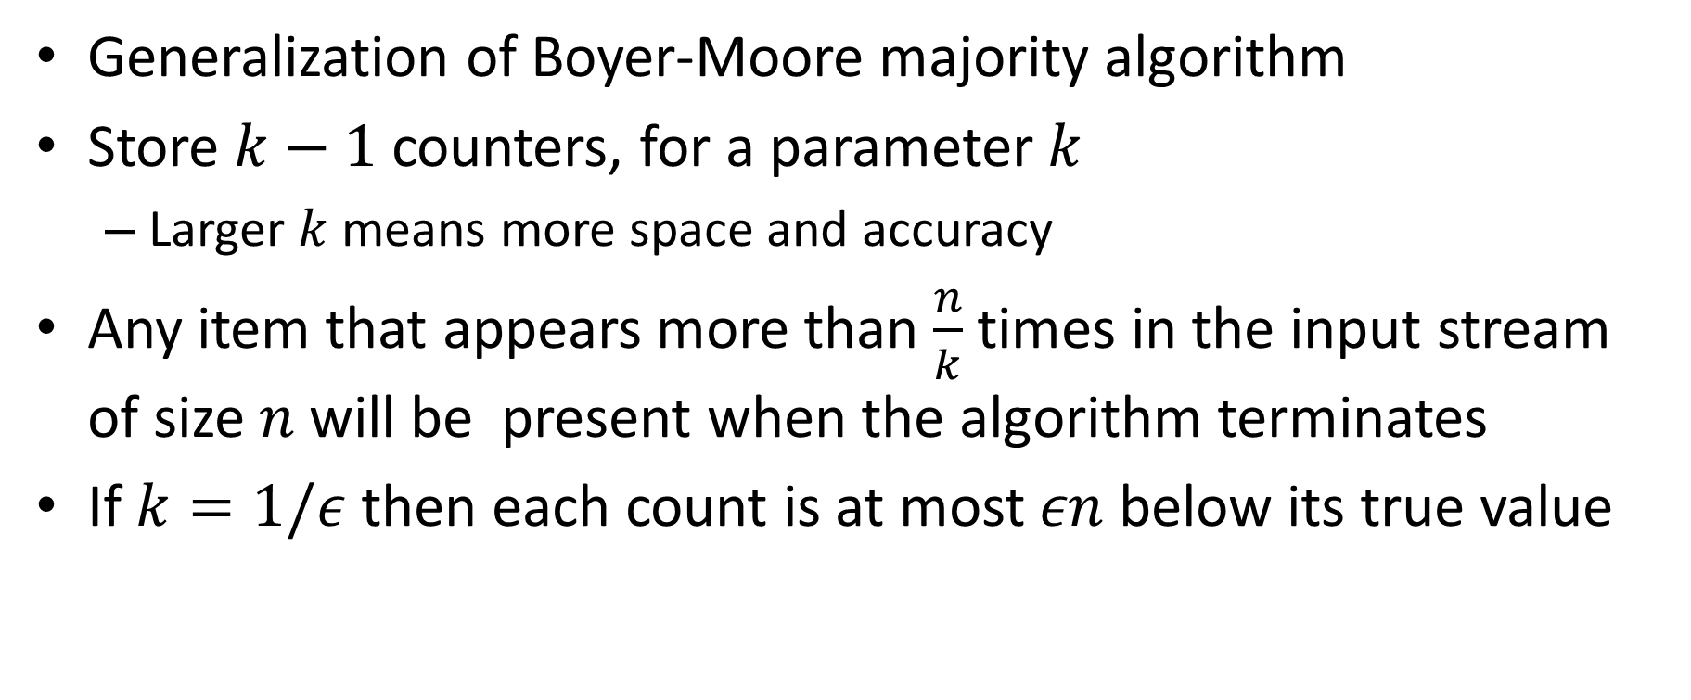
2. Misra-Gries
Generalization of Boyer-Moore majority algorithm
Store $k−1$ counters, for a parameter $k$
Larger $k$means more space and accuracy
Any item that appears more than $\frac{n}{k}$ times in the input stream of size $n$will be present when the algorithm terminates
If $k=1/ε$ then each count is at most $εn$ below its true value

Slide 14
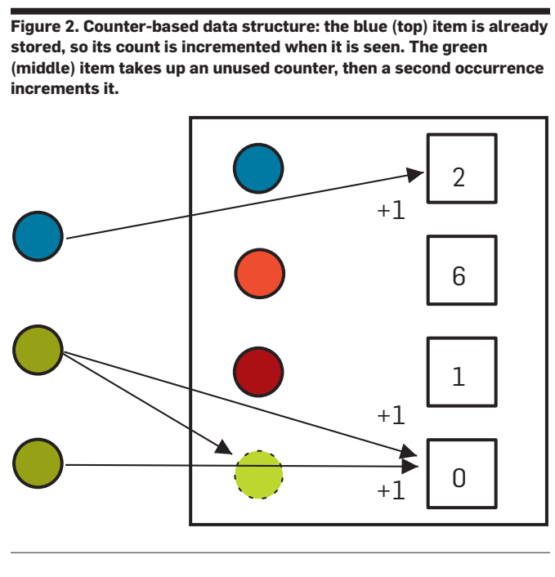
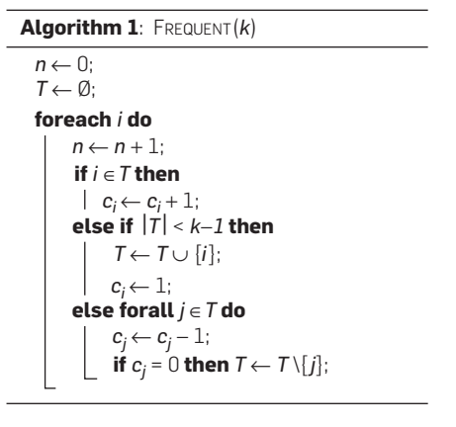
Misra-Gries algorithm in action
Finding the Frequent Items in Streams of Data, Cormode and Hadjieleftheriou, CACM 52(10), October 2009

Slide 15
3. Find popular recent items
Want to be able to naturally update this over time
Think of popular: movies, shopping items, web pages, etc.
We could run, e.g., Misra-Gries on a sliding window
This is both impractical and wrong
Wrong because the importance of an item should not “fall off a cliff” when it moves outside of our window
Our input will be, for an item, a series of counts
100 people bought this yesterday, 50 people the day before, etc.

Slide 16
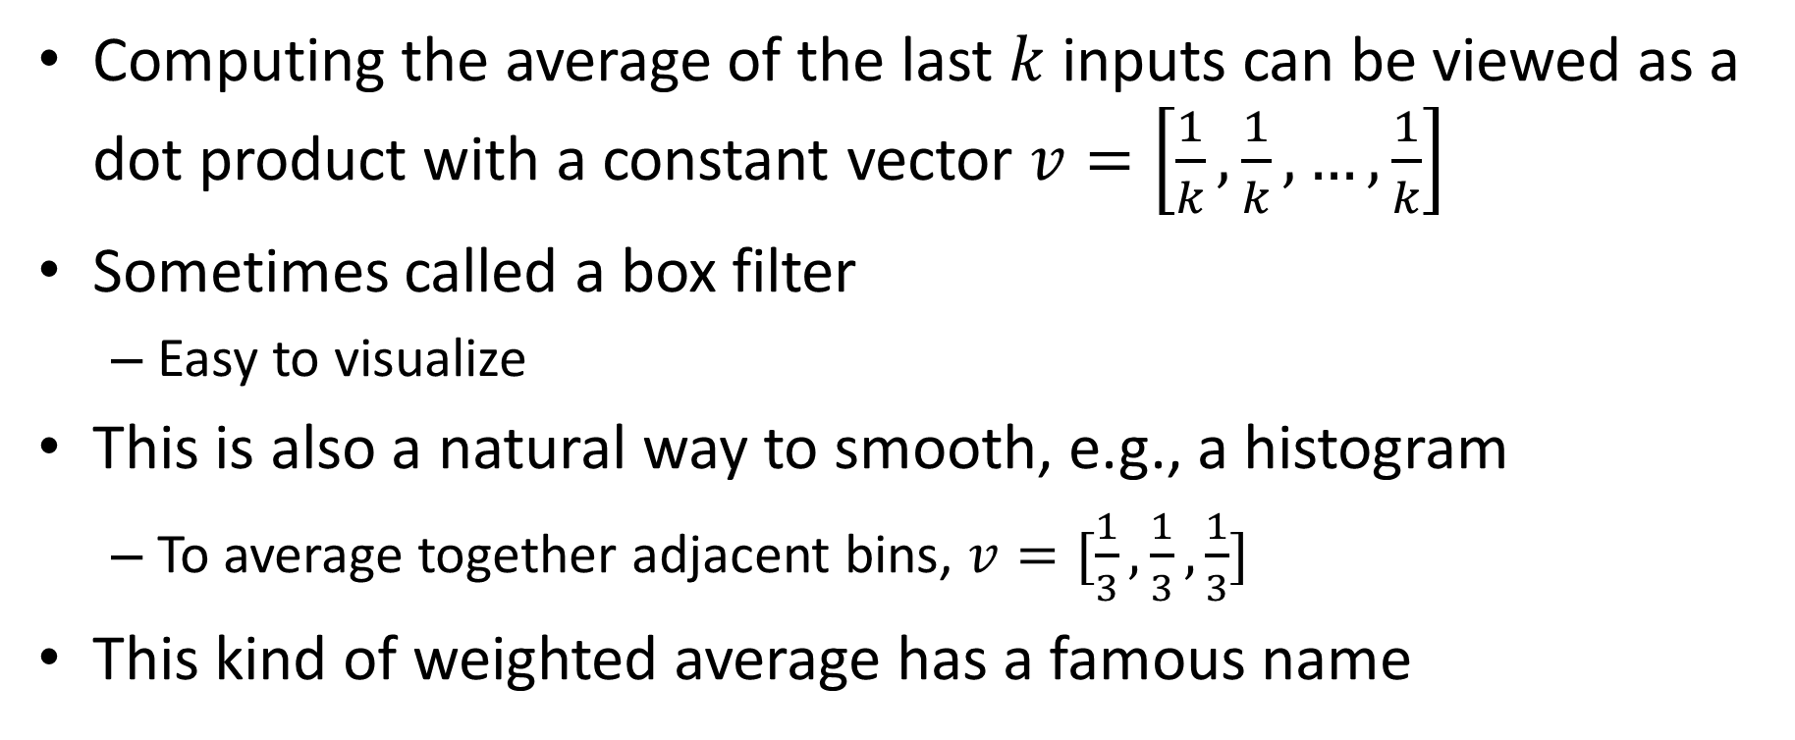
Weighted average in a sliding window
Computing the average of the last $k$ inputs can be viewed as a dot product with a constant vector $v=\left[\frac{1}{k},\frac{1}{k}, …,\frac{1}{k}\right]$
Sometimes called a box filter
Easy to visualize
This is also a natural way to smooth, e.g., a histogram
To average together adjacent bins, $v=[\frac{1}{3},\frac{1}{3},\frac{1}{3}]$
This kind of weighted average has a famous name

Slide 17
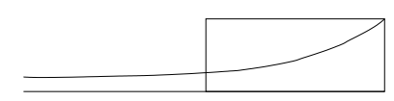
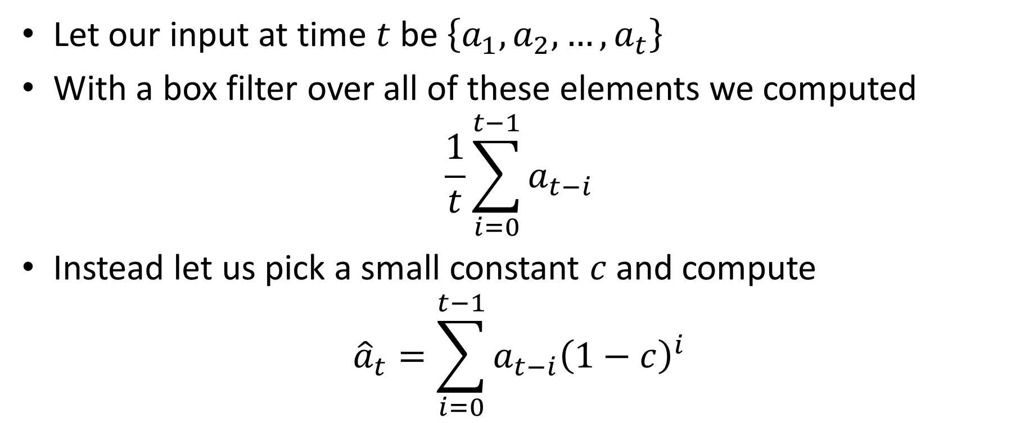
Decaying windows
Let our input at time $t$ be $\left\{a_{1},a_{2},…, a_{t}\right\}$
With a box filter over all of these elements we computed
$$\frac{1}{t}\sum_{i=0}^{t−1}{a_{t−i}}$$
Instead let us pick a small constant $c$and compute
$${\hat{a}}_{t}=\sum_{i=0}^{t−1}{a_{t−i}{\left(1−c\right)}^{i}}$$

Slide 18
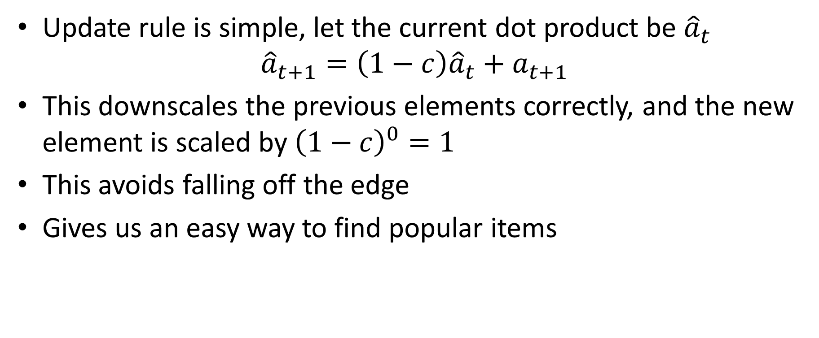
Easy to update this
Update rule is simple, let the current dot product be ${\hat{a}}_{t}$
$${\hat{a}}_{t+1}=\left(1−c\right){\hat{a}}_{t}+a_{t+1}$$
This downscales the previous elements correctly, and the new element is scaled by ${\left(1−c\right)}^{0}=1$
This avoids falling off the edge
Gives us an easy way to find popular items

Slide 19
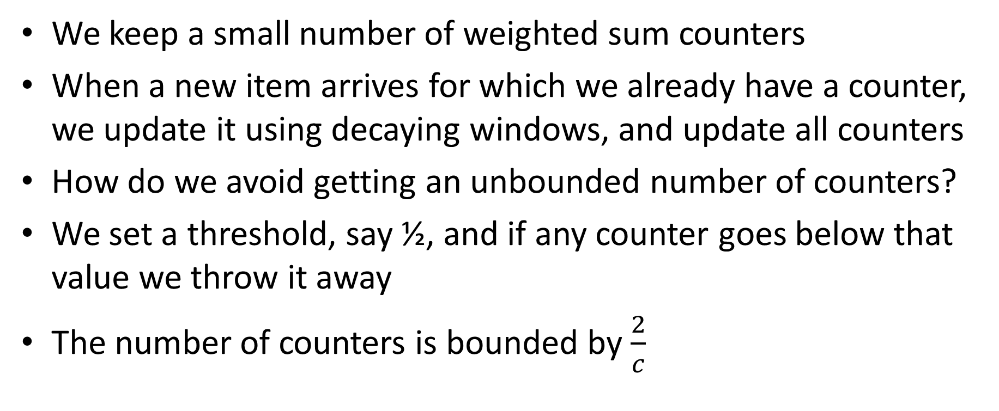
4. Popular items with decaying windows
We keep a small number of weighted sum counters
When a new item arrives for which we already have a counter, we update it using decaying windows, and update all counters
How do we avoid getting an unbounded number of counters?
We set a threshold, say ½, and if any counter goes below that value we throw it away
The number of counters is bounded by $\frac{2}{c}$

Slide 20
How many distinct items are there?
This tells you the size of the histogram, among other things
To solve this problem exactly requires space that is linear in the size of the input stream
Impractical for many applications
Instead we will compute an efficient estimate via hashing

Slide 21
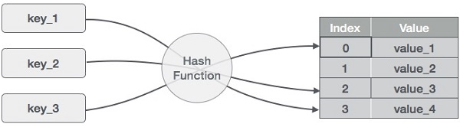
Hashing in one diagram

Slide 22
What makes a good hash function?
Almost nobody writes their own hash function
Like a random number generator, very easy to get this wrong!
Deterministic
Uniform
With respect to your input!
Technical term for this is entropy
(Sometimes) invariant to certain changes
Example: punctuation, capitalization, spaces

Slide 23
Examples of good and bad hash functions
Suppose we want to build a hash table for CS5112 students
Is area code a good hash function?
How about zip code?
Social security numbers?
https://www.ssa.gov/history/ssn/geocard.html
What is the best and worst hash function you can think of?

